Slide 1
A Simple Bayesian Game Prediction Model
By: Jake Flancer
Notes:
Introduce Self

Slide 2
The Motivation
Applying bayesian techniques
Expressing uncertainty in predictions and comparisons
Working with limited data
Notes:
Create a model to easily quantify uncertainty in team strength and game level predictions
Applying a Bayesian approach to the problem, as this framework is underutilized in hockey
Build the model only using GF and GA. Allows approach to be transferred to leagues with much less data

Slide 3
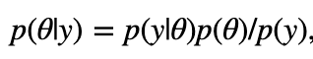
Bayesian Statistics
Examining parameters under uncertainty (distributions)
Incorporating prior beliefs in predictions
Prior “fake” data + Observed data = Estimate
Prior
Posterior
Data Likelihood
Normalizing Constant

Slide 4
Bayesian Statistics
Examining parameters under uncertainty
Incorporating prior beliefs in predictions
Prior “fake” data + Observed data = Estimate
Prior
Posterior
Data Likelihood
Normalizing Constant

Slide 5
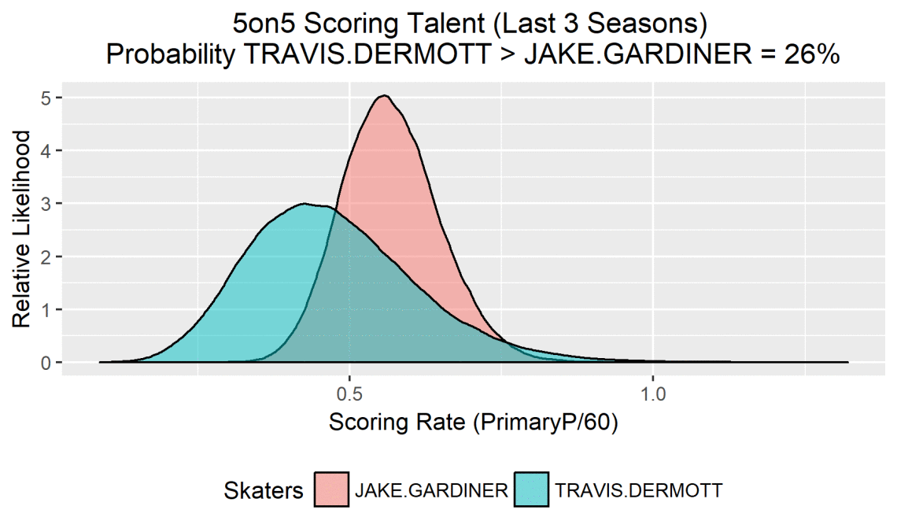
Prior Work in Hockey
Modeling goal scoring as a Poisson distribution by Alan Ryder (1)
Goalie Research by Cole Anderson (2)
Skater Scoring Talent by Domenic Galamini (3)
Bayesian analysis of the 2016 Blue Jackets by Muneeb Alam (4)
Via. Domenic Galamini Jr.
http://www.hockeyanalytics.com/Research_files/Poisson_Toolbox.pdf
http://www.crowdscoutsports.com/game-theory/expected-goal-xg-model/
https://hockey-graphs.com/2018/06/21/comparing-scoring-talent-with-empirical-bayes/
https://hockey-graphs.com/2016/12/27/how-good-is-columbus-a-bayesian-approach/#more-14342
Notes:
DELETE THIS (or just the graph)

Slide 6
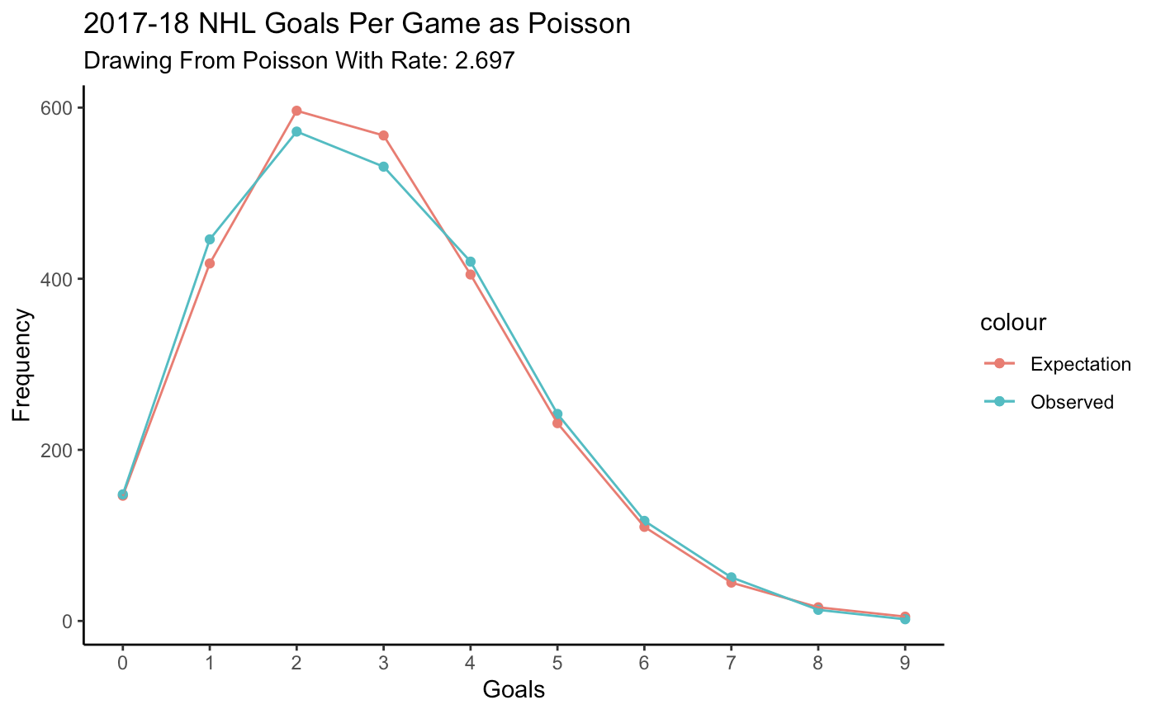
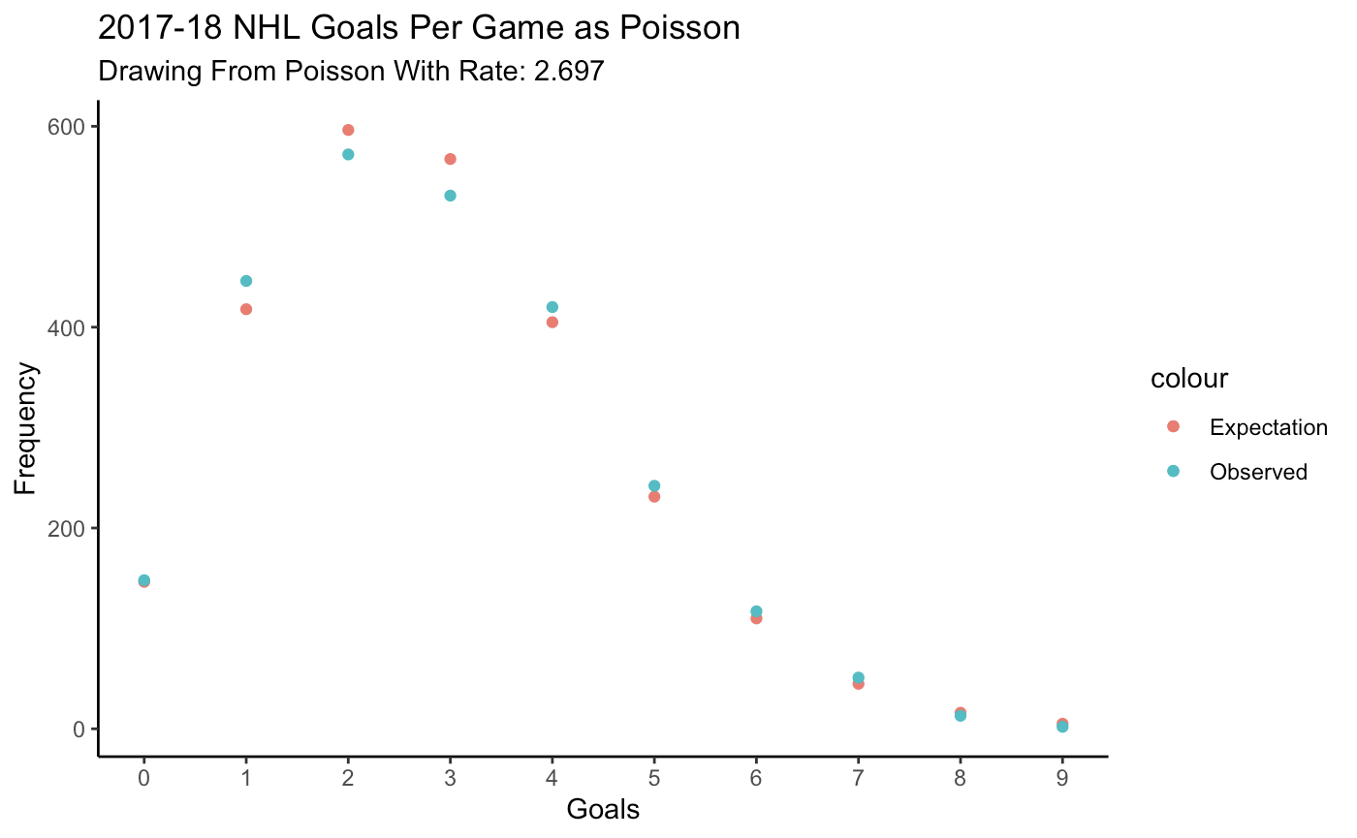
Using the Poisson Distribution
Notes:
Discrete Probability Distribution
Number of Events in a fixed interval of time
**Consider Deleting

Slide 7
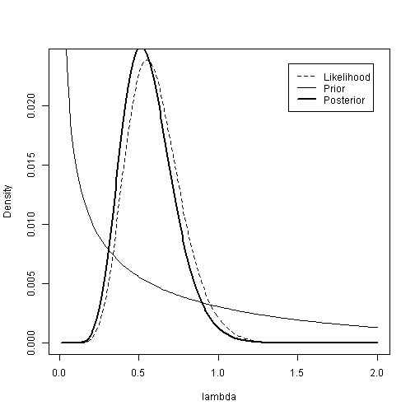
Poisson-Gamma Conjugacy
Prior: 𝞱 ~ Gamma(𝛂,𝜷)
Data: Y | 𝞱 ~ Goals Scored (Poisson)
Posterior: 𝞱 | Y ~ Gamma(∑y_{i} + 𝛂, 𝜷 + n)
Prior Mean = 𝛂/𝜷
Data Mean = ∑y_{i} / n
Posterior Mean = (∑y_{i} + 𝛂) / (𝜷 + n)
https://www4.stat.ncsu.edu/~reich/st590/code/PoissonGamma

Slide 8
How does this help?
Team A: 1 GP / 5 GF / 2 GA
Team B: 50 GP / 250 GF / 100 GA
Which team is better?
Same GF% (71.4%)
Same GF/GP (5)
Same GA/GP (2)
http://varianceexplained.org/r/empirical_bayes_baseball/

Slide 9
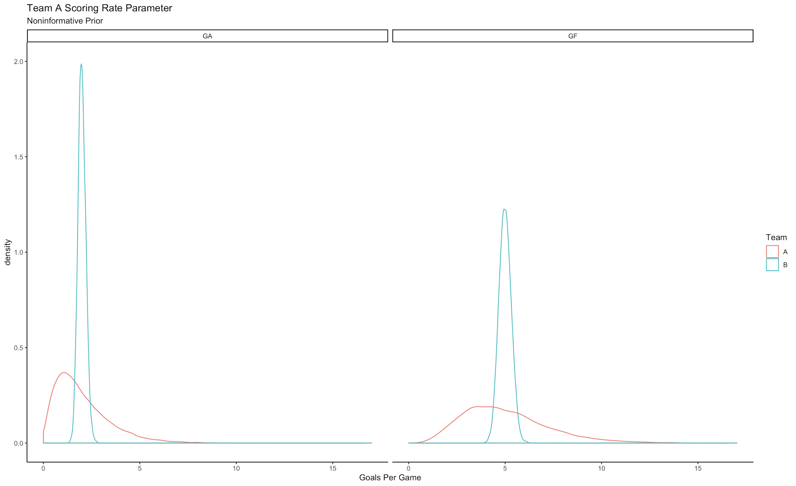
Uncertainty!

Slide 10
Translating to Hockey...
Breaking apart into team level two parameters
𝜽_{GF} = Goals For Per Game (GF Rate)
𝜽_{GA} = Goals Against Per Game (GA Rate)
Notes:
**Consider Deleting

Slide 11
Prior Distribution
Prior: 𝞱 ~ Gamma(𝛂,𝜷)
League Average: 2.6 G/GP (non-OT)
𝛂 = 2.6 * 𝜷
Team Specific:
𝛂 = 2.6 * 𝜷 * (⅓) + GF Per Game_{Team Season-1}* 𝜷 * (⅔)
𝛂 = “Prior” Goals For
𝜷 = “Prior” Games Played
Notes:
**Consider Deleting

Slide 12
Prior Distribution
Using the following:
“Prior GP” = 20 = 𝜷
Team Specific Prior
Regressed 33% to league average
Ex: 2018-19 Lightning Prior
𝛂 = 2.6 * 20 * (⅓)+ (284/82) * 20 * (⅔) = 64
𝜷 = 20
T.B Goal Scoring ~ Gamma(64, 20)
Notes:
**Consider Deleting

Slide 13
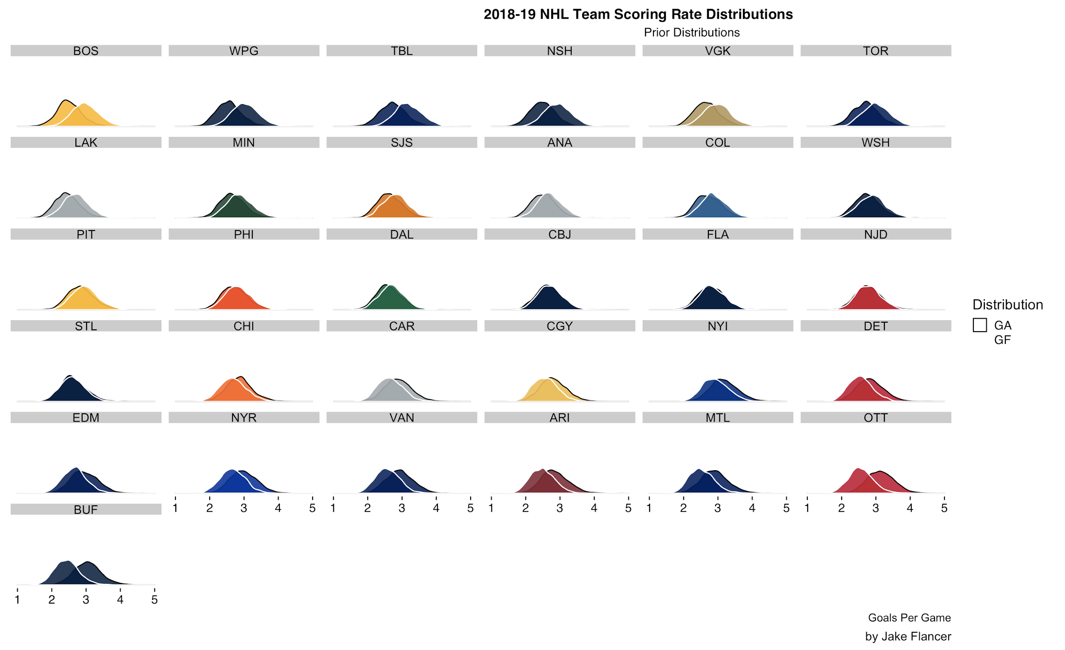
Prior Distribution

Slide 14
Observed Data
Data: Y | 𝞱 ~ Poisson Process
“Cumulative Goals Scored”
Game (n): 1, 2, 3, 4, 5
Goals: 3, 3, 4, 2, 0
∑y_{i} : 3, 6, 10, 12, 12
Notes:
**Consider Deleting

Slide 15
Posterior Distribution
Posterior: 𝞱 | Y ~ Gamma(∑y_{i} + 𝛂, 𝜷 + n)
Gamma(“Prior GF” + Cumulative Goals, “Prior GP” + Total GP)
Game 0 (Prior): 𝜽 ~ Gamma(64 + 0, 20 + 0)
Game 10: 𝜽 ~ Gamma(64 + 30, 20 + 10)
...
Game 82: 𝜽 ~ Gamma(64 + 284, 20 + 82)

Slide 16
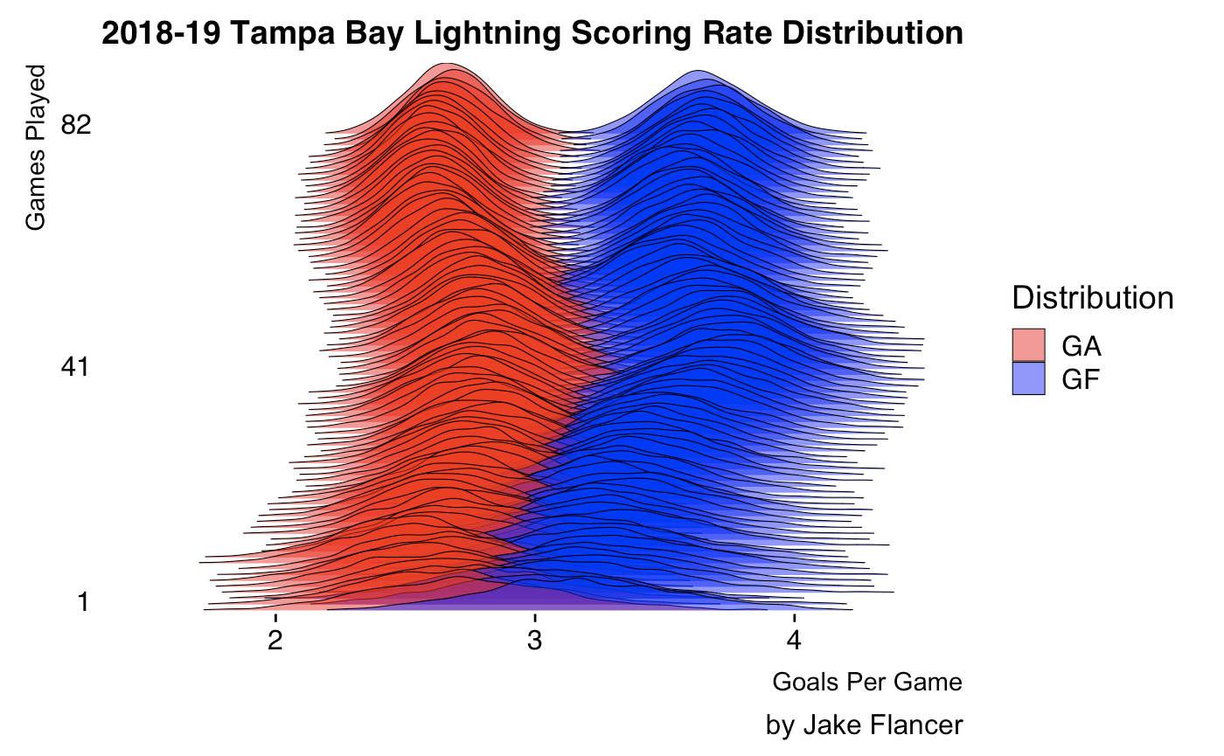
Posterior Distribution

Slide 17
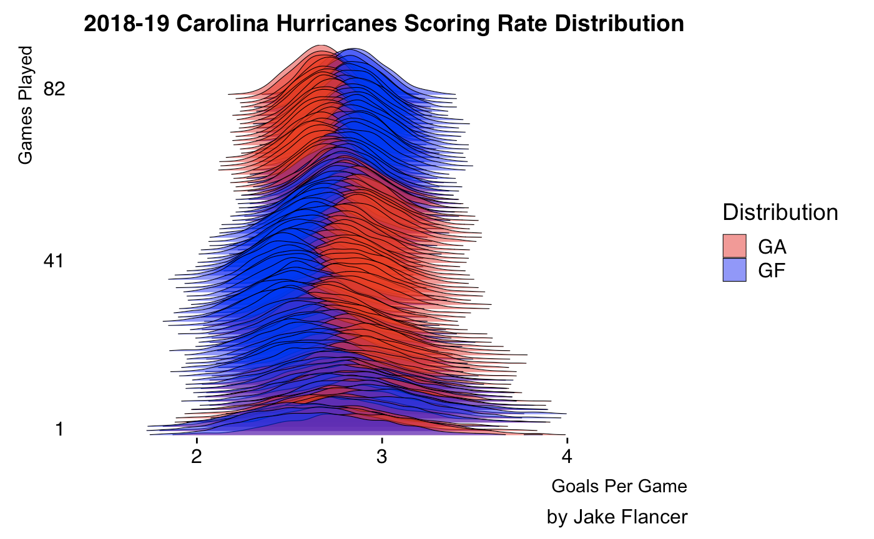
Posterior Distribution

Slide 18
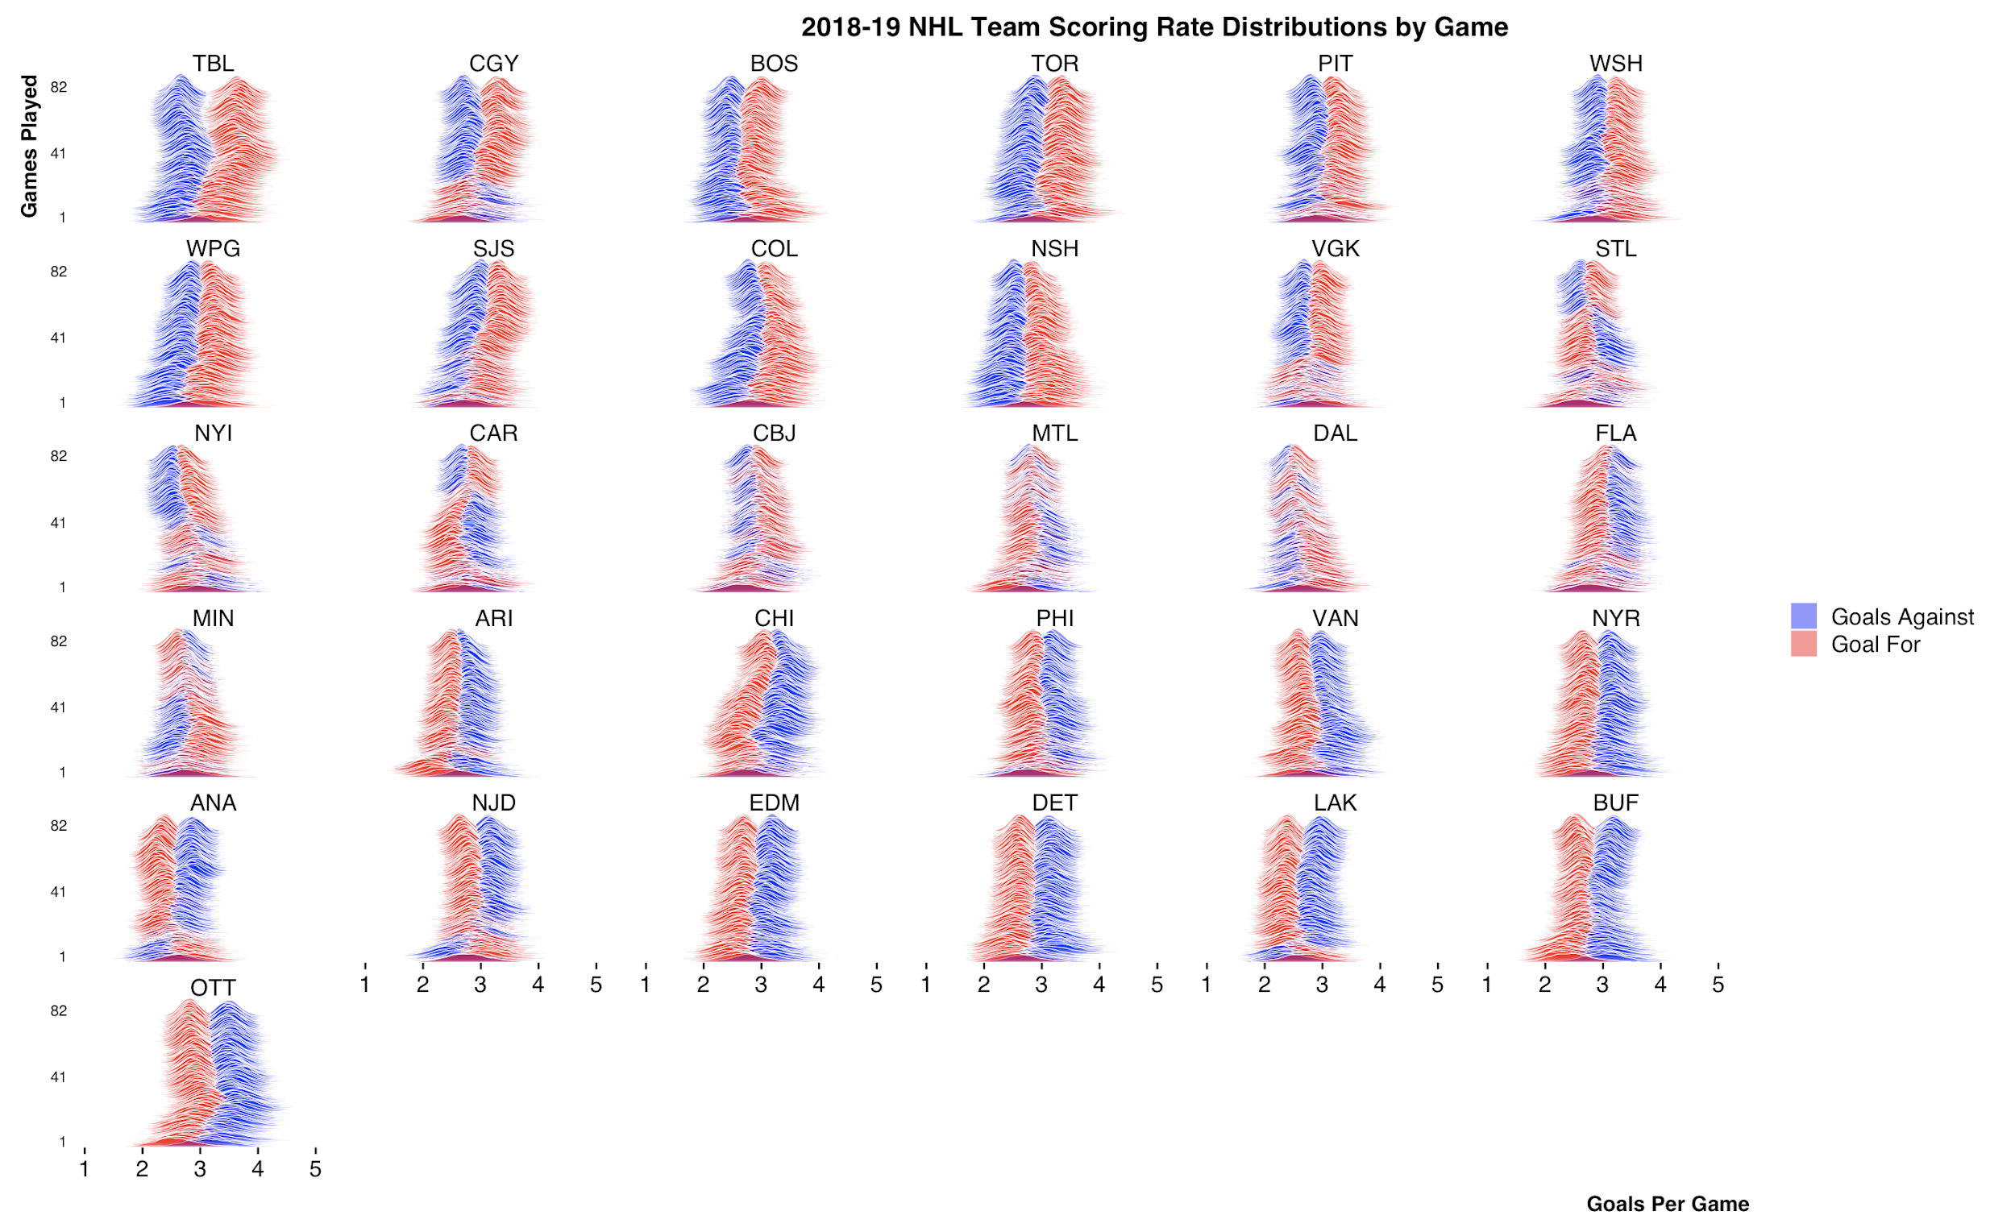
Posterior Distribution

Slide 19
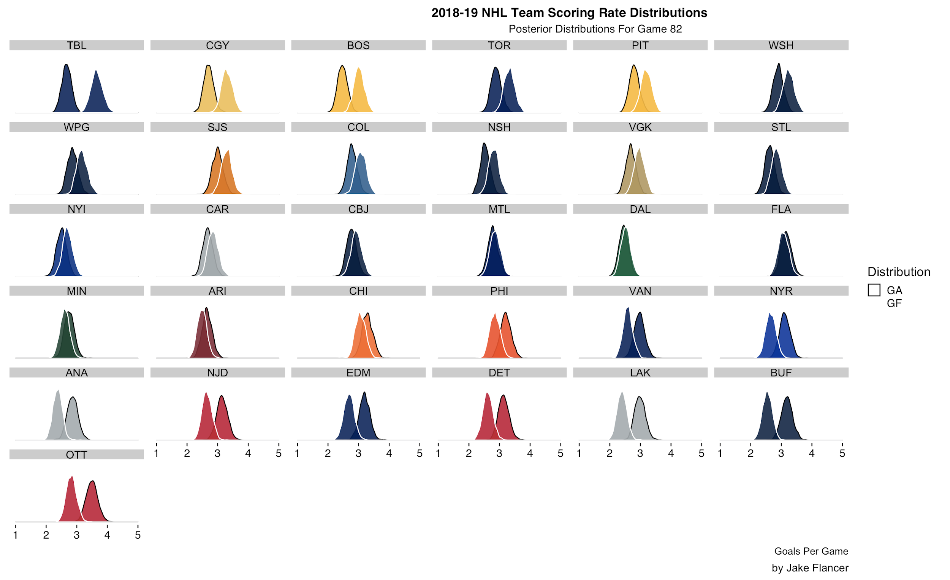
Posterior Distribution

Slide 20
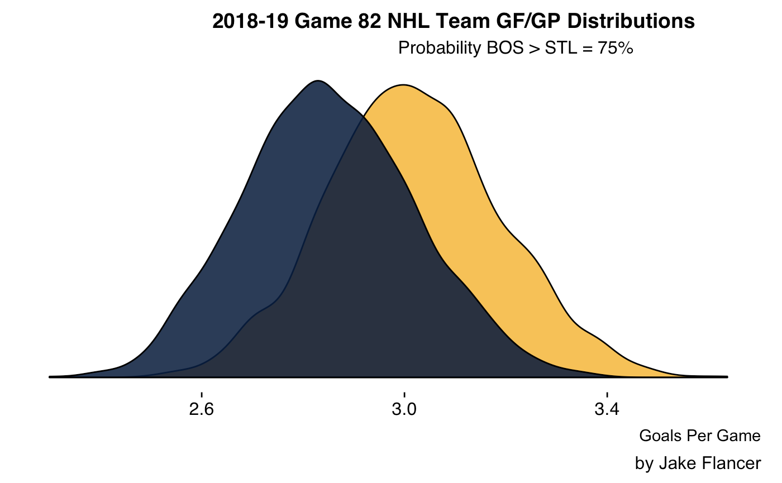
Interpreting the Posterior

Slide 21
Now what?
Current:
Posterior only yields P(𝜽₁ > 𝜽₂)
Can make probability statements about team parameters
“The distribution of the expectation”
Goal:
Game Outcomes
“The distribution of the outcomes”

Slide 22
Posterior Predictive
Create “new” observations by...
Take sample 𝜽* from posterior: 𝜽* ~ Gamma(∑y_{i} + 𝛂, 𝜷 + n)
Using 𝜽* generate a new prediction y*: y* ~ Poisson(𝜽*)
Repeat 1-2 for many draws of 𝜽* from posterior
Notes:
**Consider Deleting

Slide 23
Game Simulations
Want to include information from both teams
Four Gamma Parameters: 𝜽_{GF Home Team} | 𝜽_{GA Home Team} | 𝜽_{GF Away Team} | 𝜽_{GA Away Team}
Each parameter has two “hyperparameters”:
A = ∑y_{i} + 𝛂 (Posterior Alpha = Prior + Observed Goals Scored)
B = 𝜷 + n (Posterior Beta = Prior + Observed Games Played)
Notes:
**Consider Deleting

Slide 24
Game Simulations
To keep it simple, we can add together rates
𝜽_{Home Scoring} ~ Gamma(A_{Home GF} + A_{Away GA} , B_{Home GP} + B_{Away GP})
𝜽_{Away Scoring} ~ Gamma(A_{Away GF} + A_{Home GA} , B_{Home GP} + B_{Away GP})
On average…
Home Team Goals per Game = (Home_{GF} + Away_{GA}) / (Home_{GP} + Away_{GP})
Simple Weighted Average!
Notes:
**Consider Deleting

Slide 25
Game Simulations
Now, Using 𝜽_{Home Scoring} , 𝜽_{Away Scoring} we can do predictive draws!
y*_{Home} ~ Poisson(𝜽_{Home Scoring}* 1.045)
y*_{Away} ~ Poisson(𝜽_{Away Scoring} / 1.045)
Can now compare y*_{Home} and y*_{Away} to generate distributions of game outcomes
When y*_{Home} > y*_{Away} , Home Team Wins
When y*_{Home} = y*_{Away} , OT. Determined by binomial with p_{home} = 52%
To account for home advantage, I use a simple constant multiplier of 1.045. This was derived by:
If you have two variables x1 ~ Poisson(3*1.045) and x2 ~ Poisson(3/1.045) you will find P(x1>x2) ~ 45% and P(x1=x2) ~ 17%
Here, 3 = League avg. G/GP. Assuming 50/50 OT, P(x1 wins) = 53.5% ~ approximate home team win percentage
Notes:
**Consider Deleting

Slide 26
Digression… The Classical Approach
A typical simulation/monte carlo approach follows the last slide very closely
However…
The parameters 𝜽 are instead simply taken from observed data
It will ignore the influence of an informative prior
This Approach was taken by Matthew Barlowe in his NHL Poisson Model (no longer publicly available)
Likely Similar to Alyssa Longmuir’s Approach: https://www.aklongmuir.com/Blog/Meet-Clementine-AIHL-Season-simulator
Notes:
**Consider Deleting

Slide 27
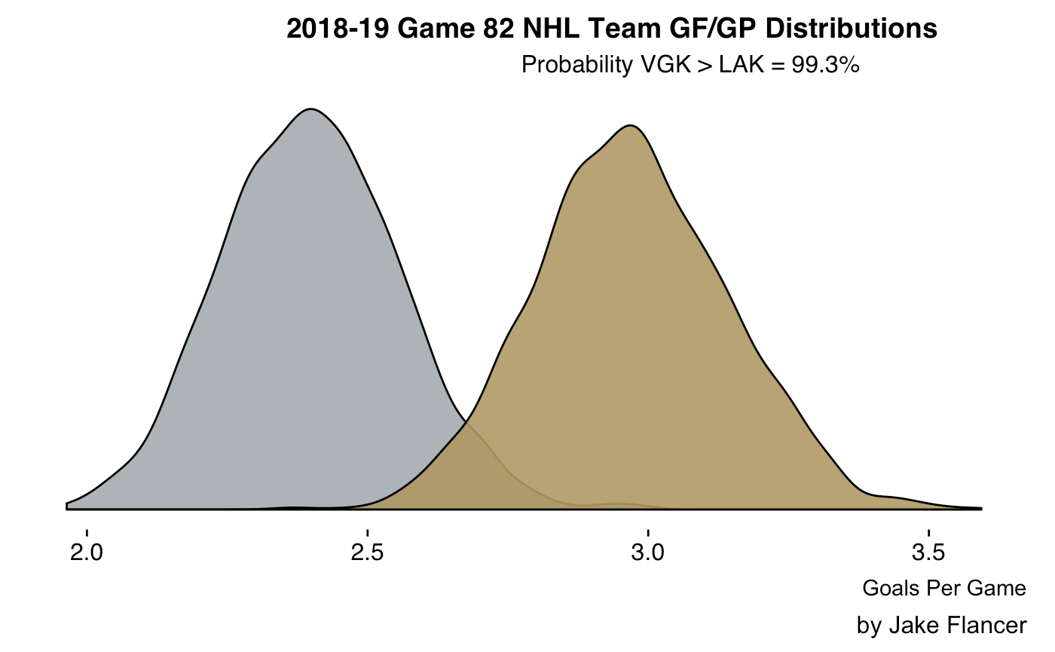
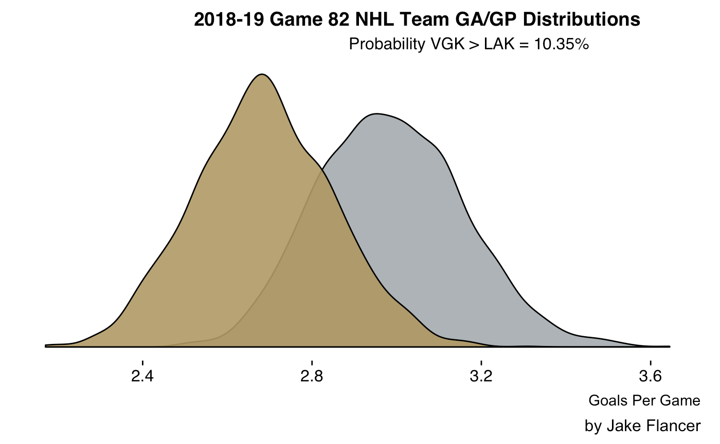
Game Prediction
Golden Knights @ Kings 04/06/2019
Posterior Distributions:
𝜽_{LAK GF} ~ Gamma(242, 101)
𝜽_{LAK GA} ~ Gamma(301, 101)
𝜽_{VGK GF} ~ Gamma(300, 101)
𝜽_{VGK GA} ~ Gamma(271, 101)
Notes:
**Consider Deleting / Changing

Slide 28
Game Prediction
Golden Knights @ Kings 04/06/2019
Posterior Distributions:
𝜽_{LAK GF} ~ Gamma(242, 101)
𝜽_{LAK GA} ~ Gamma(301, 101)
𝜽_{VGK GF} ~ Gamma(300, 101)
𝜽_{VGK GA} ~ Gamma(271, 101)

Slide 29
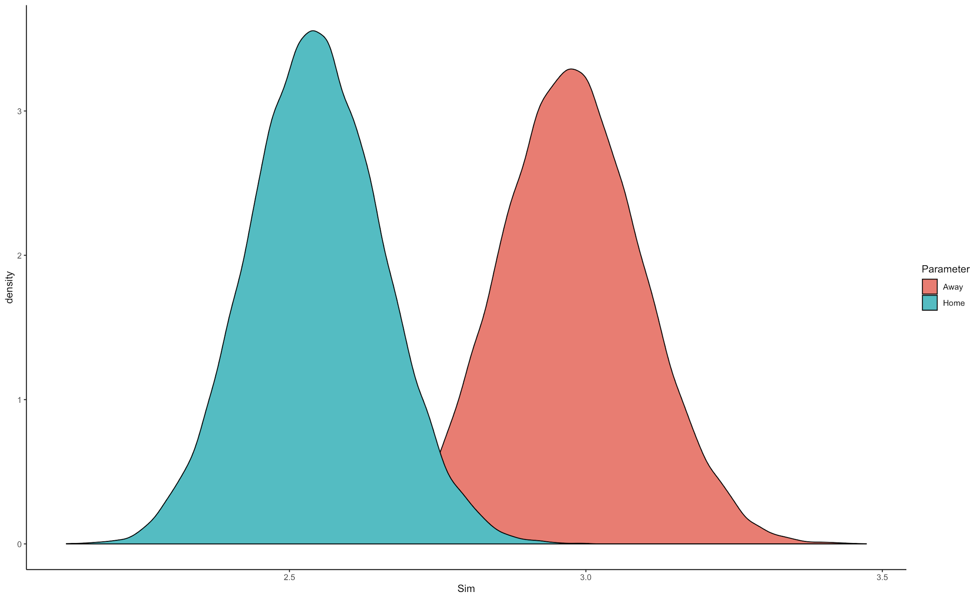
Game Prediction
Golden Knights @ Kings 04/06/2019
Game Distribution:
𝜽_{Home Scoring} ~ Gamma(514, 202)
𝜽_{Away Scoring} ~ Gamma(601, 202)
Draw Poisson From Posterior Predictive

Slide 30
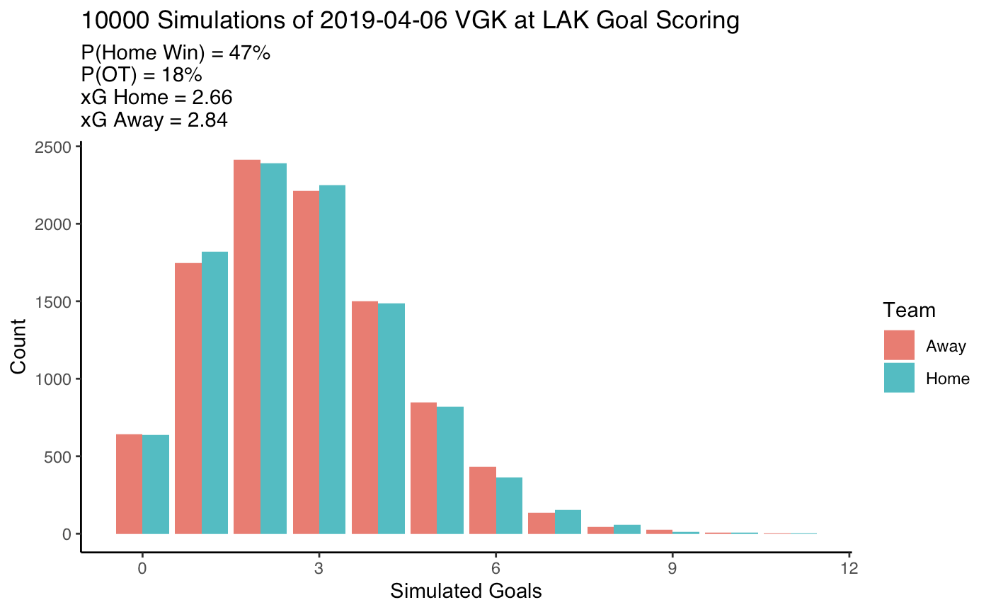
Game Prediction

Slide 31
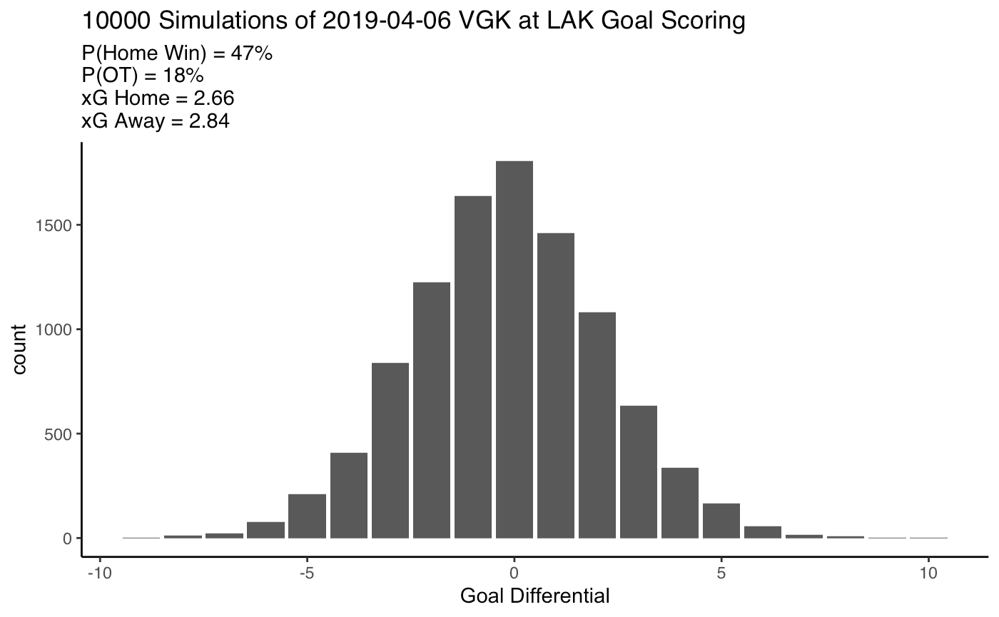
Game Prediction

Slide 32
Key Assumptions and Issues
Goal scoring is not truly poisson (score effects)
Independent GF and GA
Average OT% was 16%, in reality it is approx. 21%
Assumes 4 parameters are equally weighted
Predictions are a little over-regressed
Assumes team strength stays the same (game 1 and game 82 weighted equally)
Notes:
**Consider Deleting

Slide 33
In Summary
Uncertainty estimates
Make straightforward probabilistic team comparisons
Works with limited data
Simulate game outcomes
Cool graphs!

Slide 34
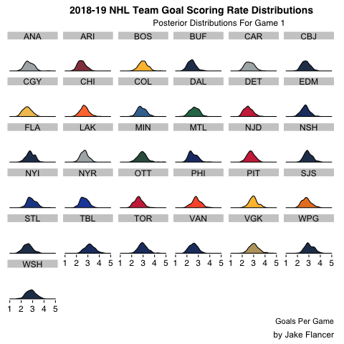
Thank You!
Feel Free To Reach Out
jflancer@wharton.upenn.edu
@jakef1873
github.com/jflancer/gameModel
Use even-strength.com!!!

Slide 35
Appendix
Data via nhl.com

Slide 36
Posterior Distribution Ridge Plots
If you have a specific team/season request please let me know, I just picked out some interesting ones but they’re easy to produce

Slide 37
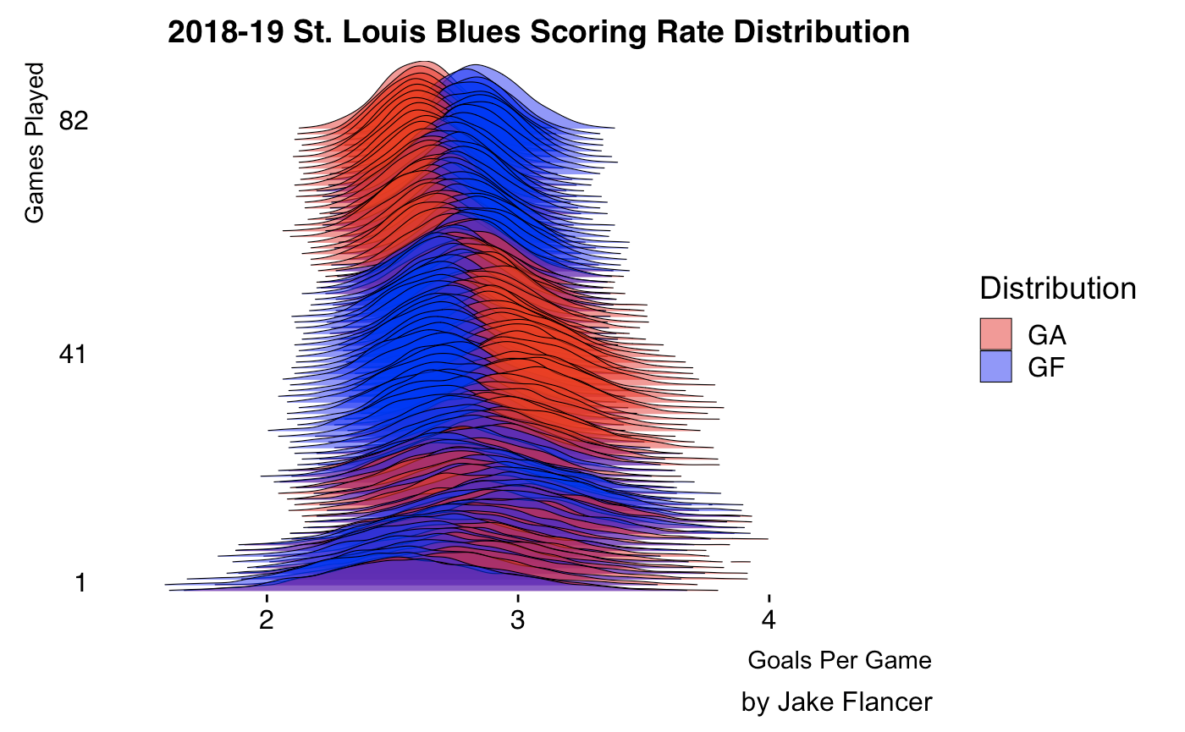
Posterior Distribution Ridge Plots

Slide 38
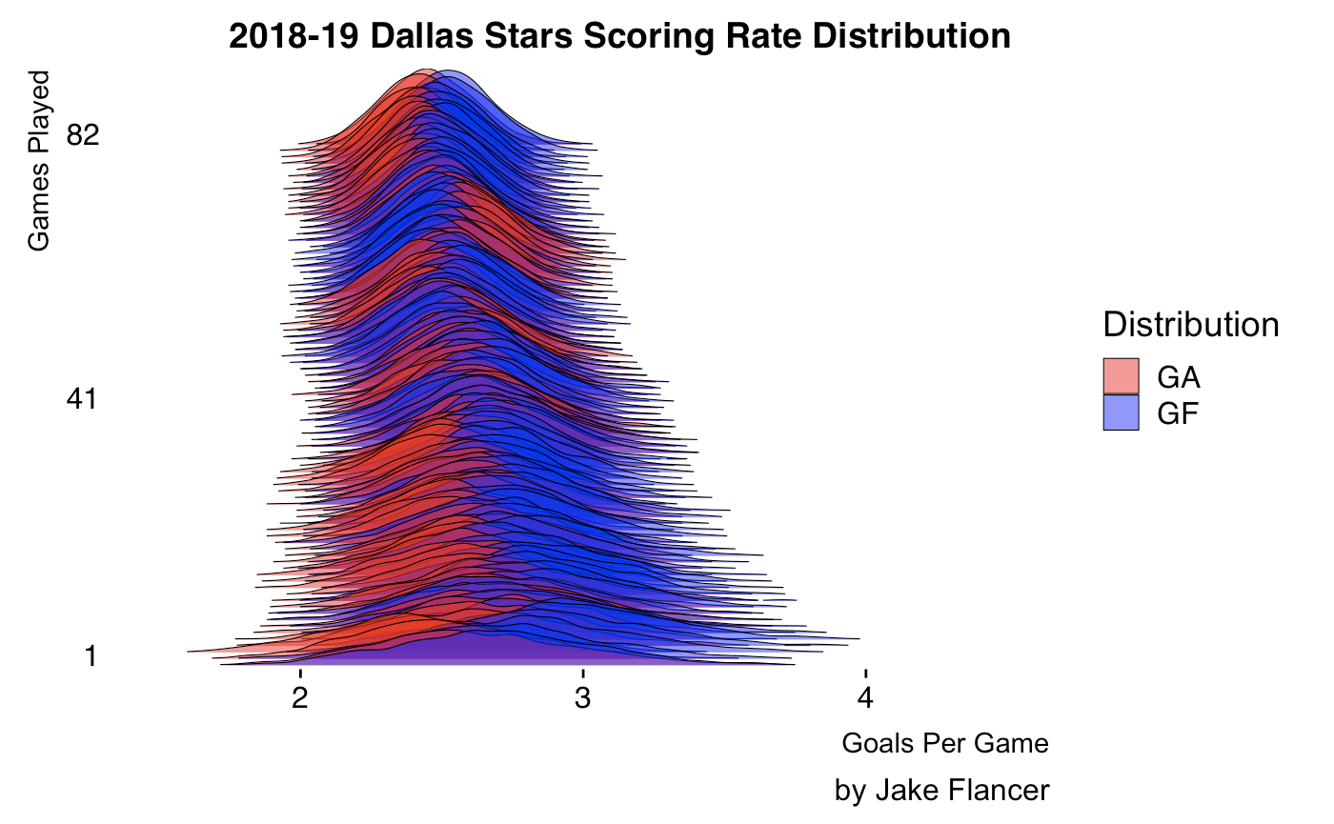
Posterior Distribution Ridge Plots

Slide 39
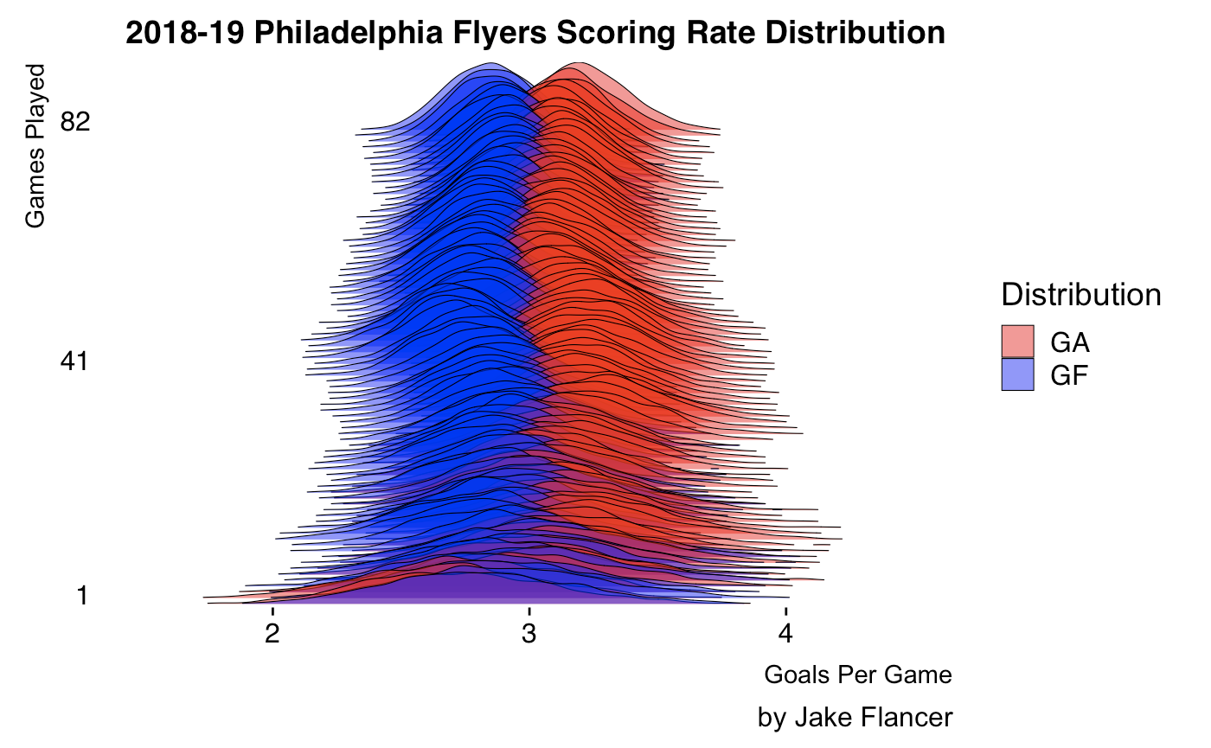
Posterior Distribution Ridge Plots

Slide 40
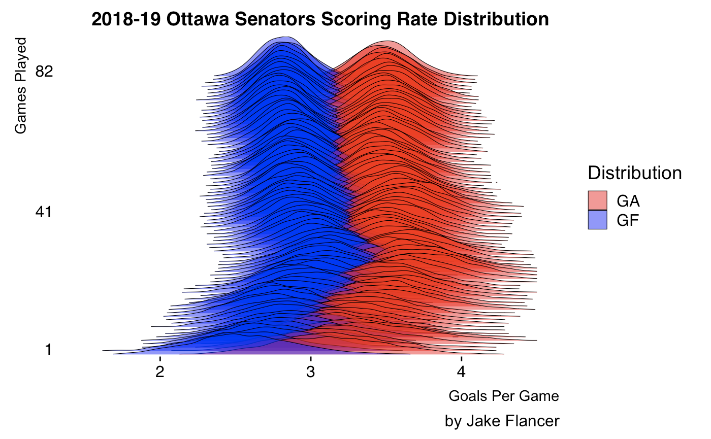
Posterior Distribution Ridge Plots

Slide 41
Model Results: Performance
Season | Prior Type | Prior Strength | |Log Loss|
2014-15 | Team | 20 | 0.6751
2015-16 | Team | 20 | 0.6862
2016-17 | Team | 20 | 0.6749
2017-18 | League | 1 | 0.6793
2017-18 | League | 20 | 0.6779
2017-18 | Team | 1 | 0.6791
2017-18 | Team | 20 | 0.6762
2018-19 | League | 1 | 0.6882
2018-19 | League | 20 | 0.6839
2018-19 | Team | 1 | 0.6882
2018-19 | Team | 20 | 0.6814
Simulation Used in Presentation:
Log Loss: -0.6817
Accuracy: 56.33%
^^^Note: Slightly Different From
Table as Presentation Uses 10,000
Sims per game, Table Uses 2,000

Slide 42
Model Results: Calibration
Bin | GP | Wins | Losses | Actual W% | Bucket W%
50% - 52.5% | 339 | 176 | 163 | 51.92% | 51.26%
52.5% - 55% | 353 | 194 | 159 | 54.96% | 53.70%
55% - 57.5% | 240 | 138 | 102 | 57.50% | 56.18%
57.5% - 60% | 199 | 116 | 83 | 58.29% | 58.63%
60% - 62.5% | 106 | 68 | 38 | 64.15% | 61.05%
62.5% - 65% | 30 | 20 | 10 | 66.67% | 63.41%
65% - 67.5% | 4 | 4 | 0 | 100% | 65.95%

Slide 43
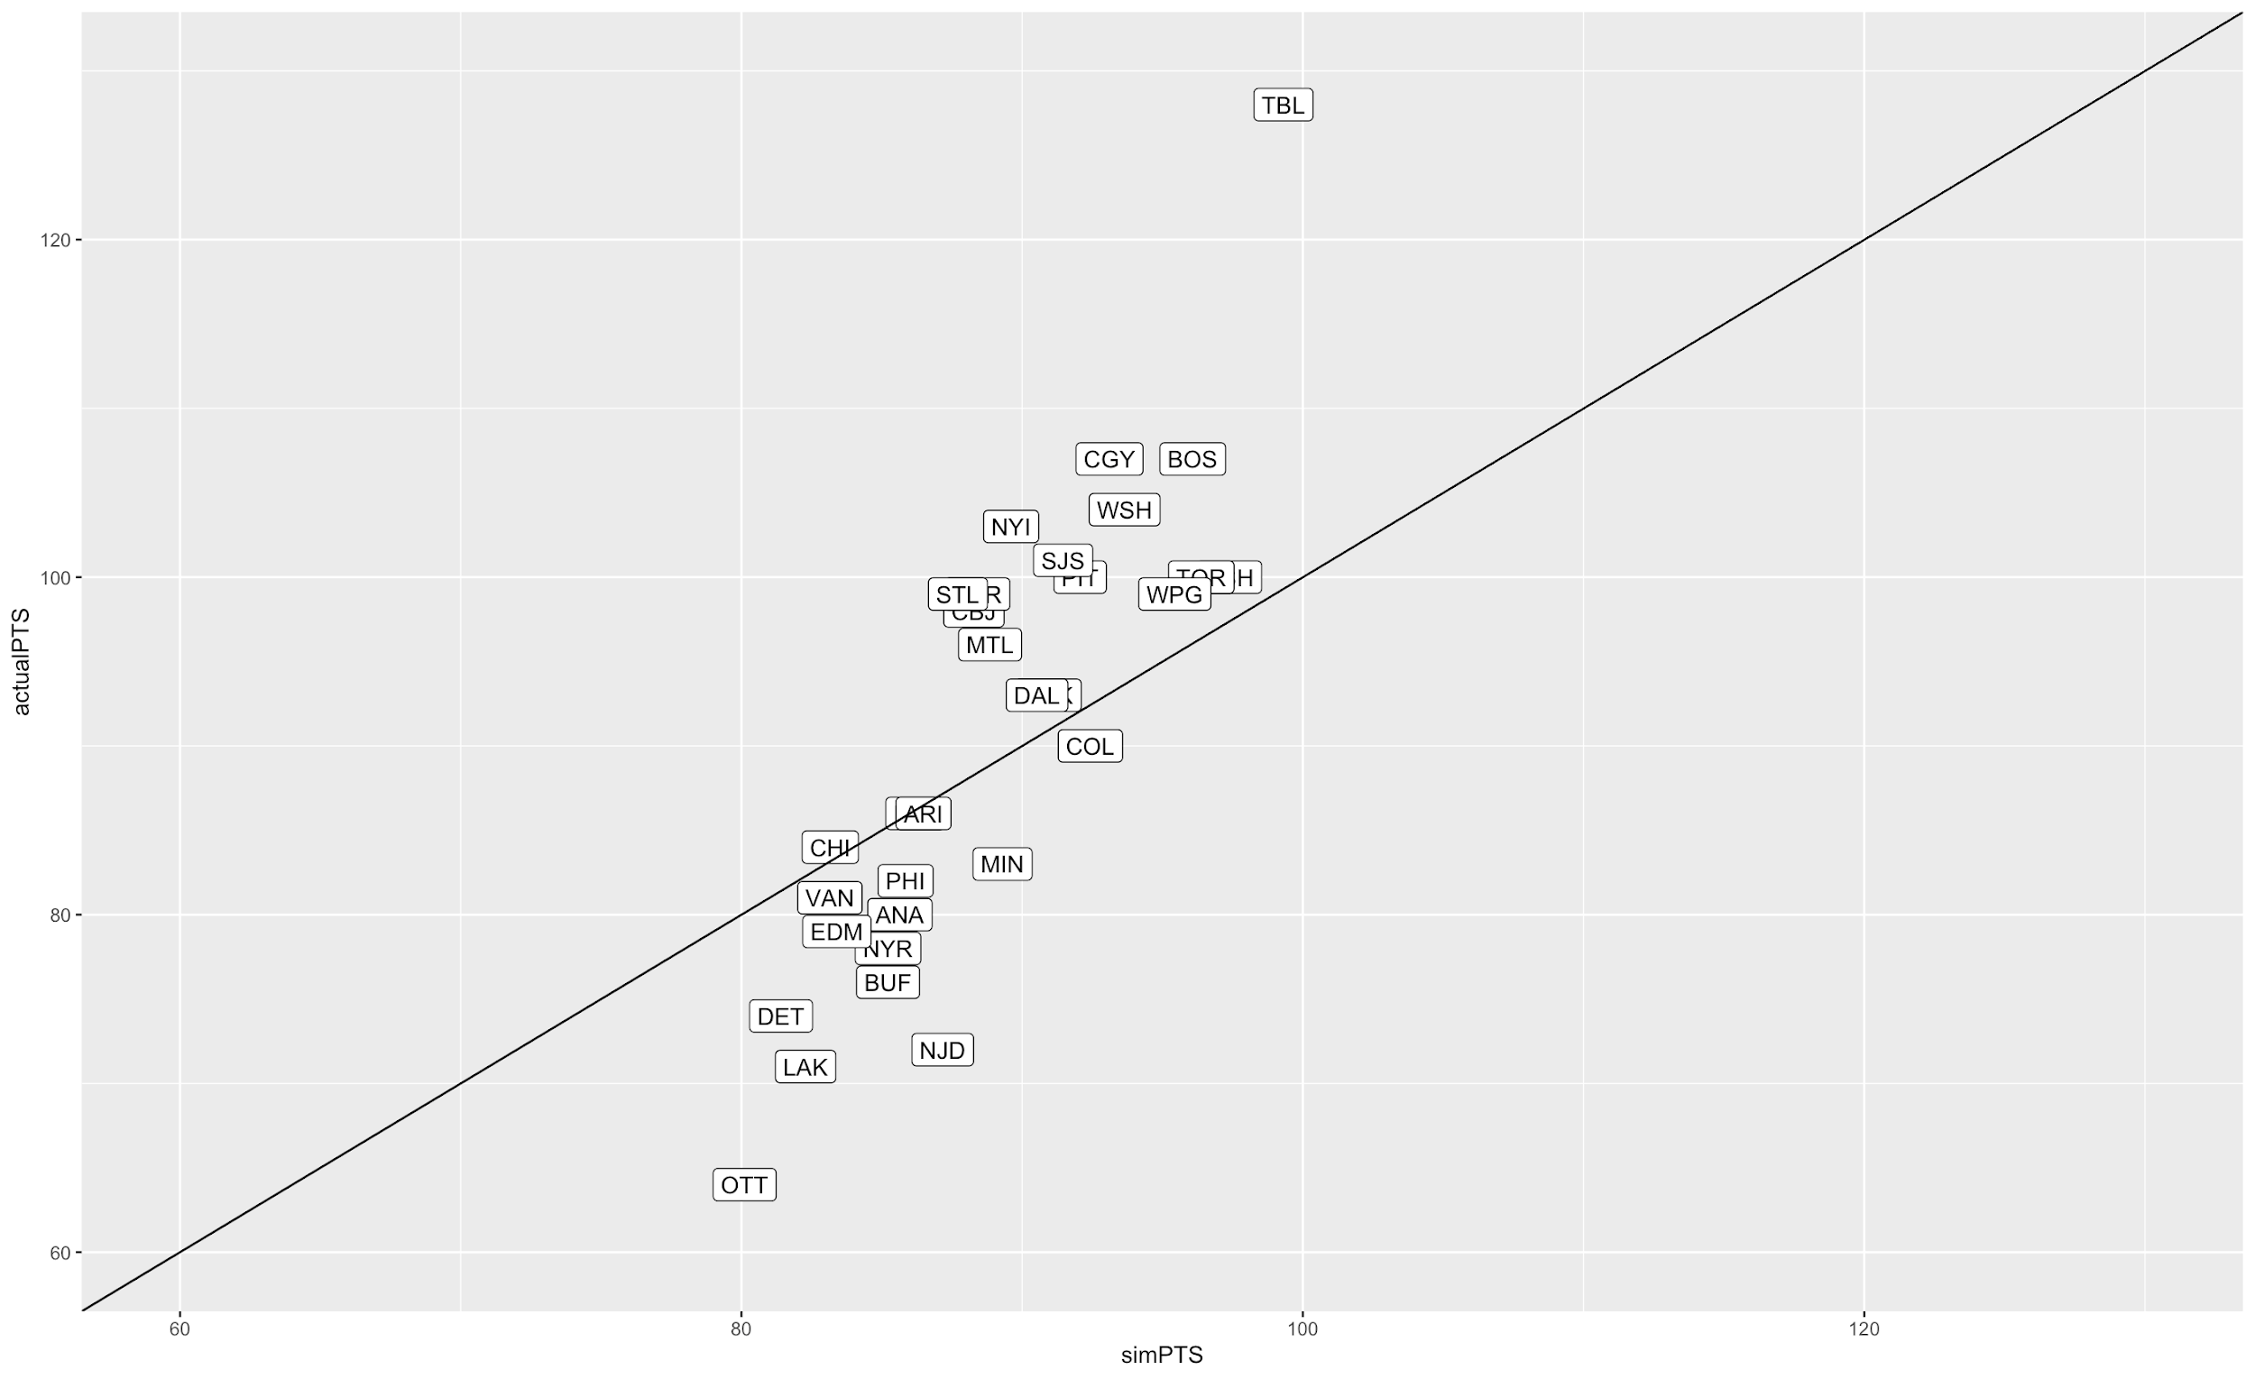
Season Results

Slide 44
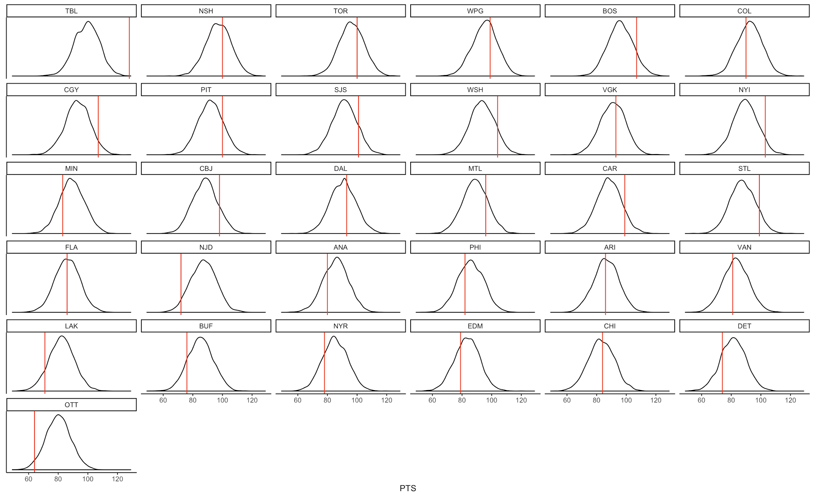
Season Results

Slide 45
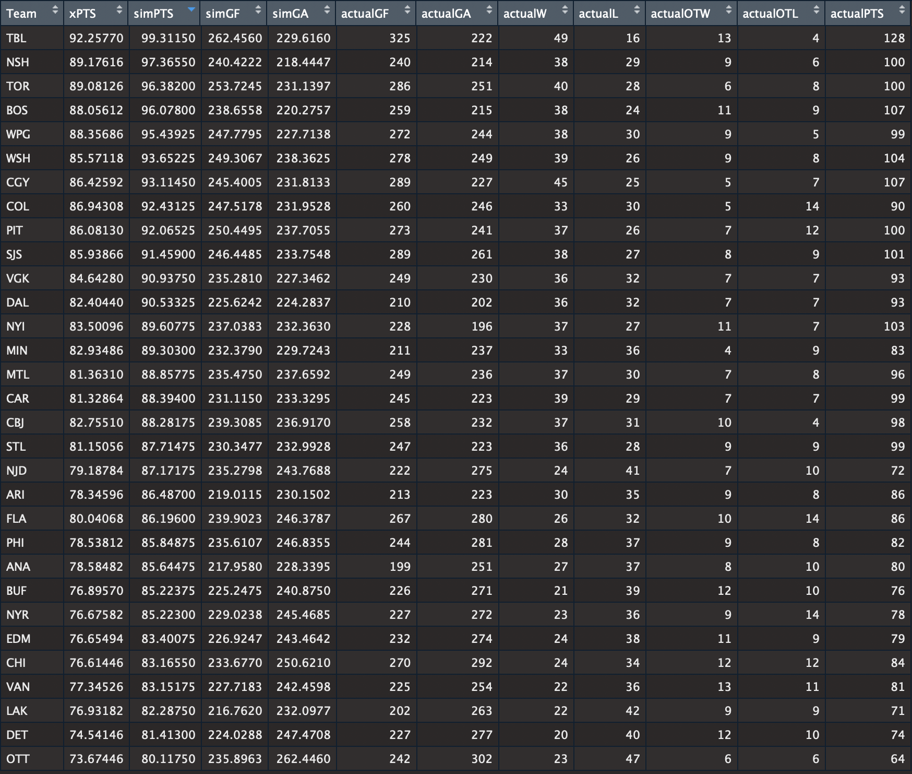
Season Results

Slide 46
Season Results
Results are too regressed!
Model Predicts OT far too often… less points assigned overall
OT determined by coin flip...
TB was 13-4 in OT/SO!
Generally too regressed to league average
Likely a result of assumption that the GF and GA parameters should be weighed equally

